Slide 1

G2M Insight For Cab Investment Firm
Exploratory Data Analysis
LISUM02
06th August 2021
By,
Joseph Antony

Slide 2

Agenda
Executive Summary
Problem Statement
Methodology
Data Preparation
EDA
EDA Summary
Forecast
Recommendations

Slide 3

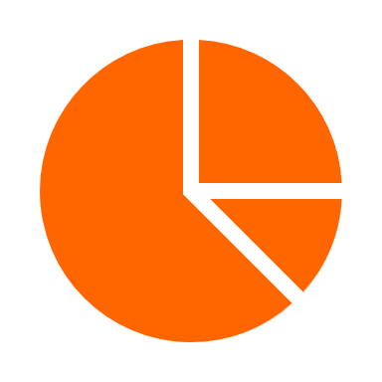


Executive Summary
This report was commissioned to summarize my findings to the client, XYZ company, for the best Cab company to invest in.
This report focuses on two Cab companies - Yellow Cab and Pink Cab.
An extensive Exploratory Data Analysis supported with Hypothesis Testing and Forecasting methodologies were utilized for this study.
Recommendation:
According to the data and two-year forecasts, Yellow Cab has been identified to perform better in terms of:
High daily number of trips on any given day
Higher Market share on most Cities
Better Customer Retention
Higher Profitability

Slide 4
Problem Statement
The Client
XYZ is a private firm in US. Due to remarkable growth in the Cab Industry in last few years and multiple key players in the market, it is planning for an investment in Cab industry and as per their Go-to-Market (G2M) strategy they want to understand the market before taking final decision.
XYZ has provided multiple data sets that contains information on two cab companies. Each data set provided represents different aspects of the customer profile. XYZ is interested in using the actionable insights obtained to help them identify the right company to make their investment.

Slide 5



Methodology
Exploratory Data Analysis (EDA)
Hypothesis Testing
Forecasting

Slide 6
Data Preparation
Four data sets that contains information on Two cab companies had been provided.
Each data set represents different aspects of the customer profile.
Time period of data is from 02nd January 2016 until 21st December 2018.
Master Dataset was created by inner joining:
Cab_Data.csv: Includes details of transaction for both cab companies.
Customer_ID.csv: Mapping table that contains a unique identifier which links the customer’s demographic details.
Transaction_ID.csv: Mapping table that contains transaction to customer mapping and payment mode.
The fourth Dataset, City.csv has been left out as it does not provide information about daily trips for both Cab companies.
Schema of Master Dataset

Slide 7

EDA Key Insights

Slide 8
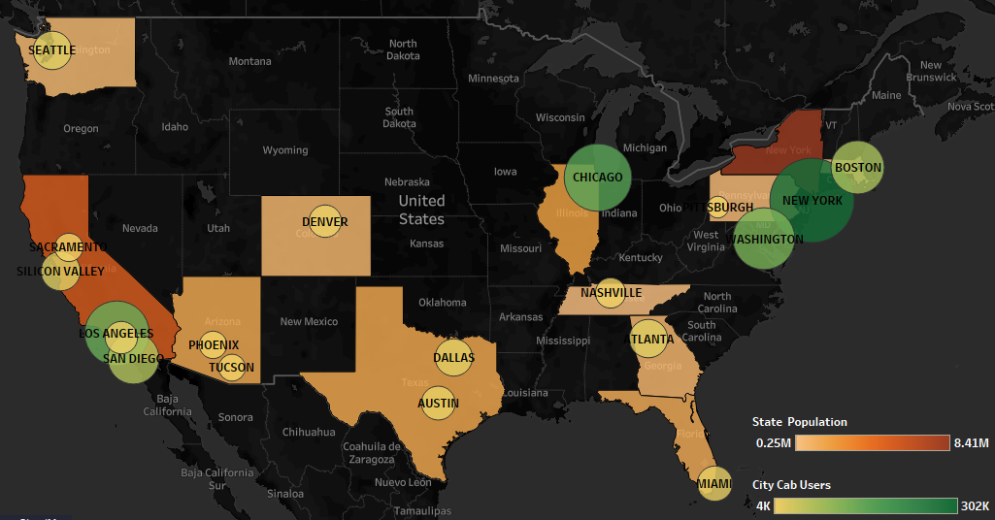
Population and Cab Users

Slide 9
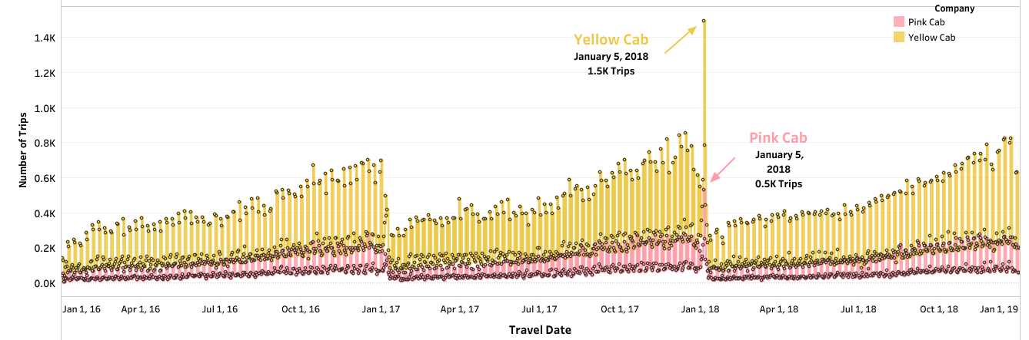
Daily Trips (2016 - 2018)
Same trip pattern for both companies.
Yellow Cab has highest trips every single day.
Jan 5th, 2018 saw the highest number of trips for both cab companies.
Beginning of every year, the trips are very low.
Conversely, at the end of the year, trips are very high.

Slide 10
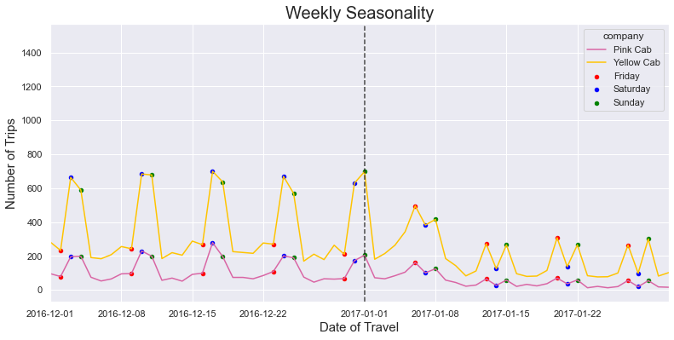
Weekly Seasonality (2016 - 2017)
Low trips on Friday, and higher trips on Saturday and Sunday in 2016.
Pattern changes in 2017, where higher trips of Friday, then lowers on Saturday and high again on Sunday.

Slide 11
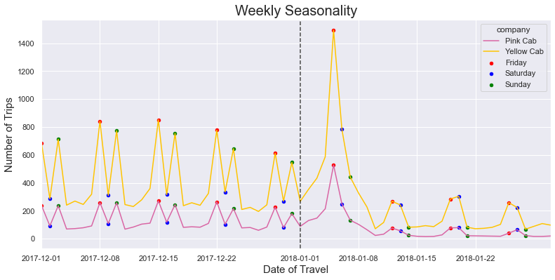
Weekly Seasonality (2017 - 2018)
In 2017, weekly seasonality changes again.
High trips on Friday, the lower trips on Saturday, followed by even lower trips on Sunday

Slide 12
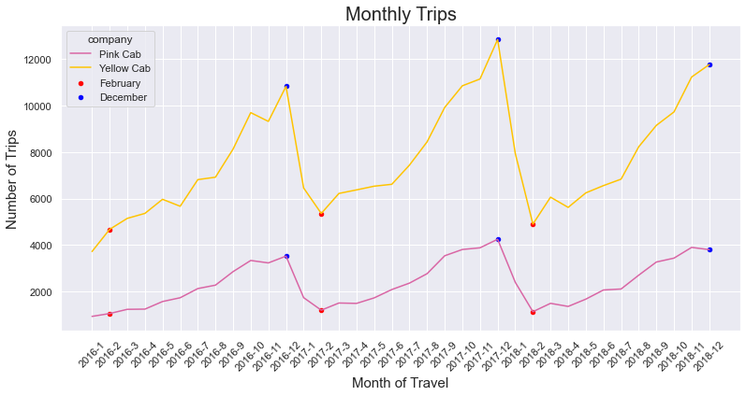
Monthly Seasonality
Highest trips in December
Lowest Trips in February.

Slide 13
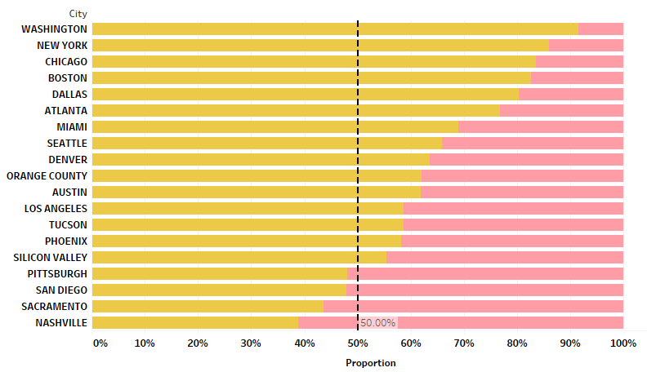
Market Share by City
Market share of Yellow Cab higher across majority of the Cities.
Pink Cab has higher market share on few cities - Nashville, Sacramento, San Diego, Pittsburgh.

Slide 14
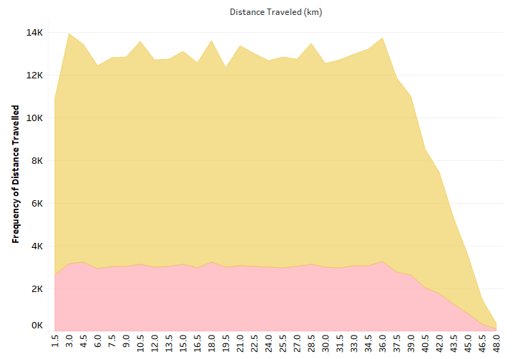
Frequency of Distance Traveled
Distance travelled remain uniform for both Cab companies.
Trips that involves travelling more than 36 km are rarer.

Slide 15
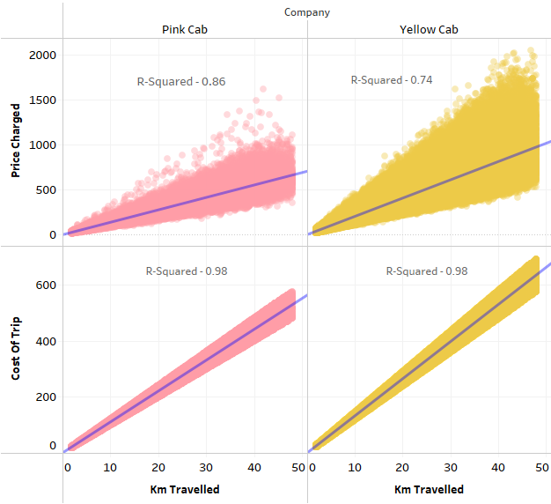
Distance vs Revenue & Expense
High Correlation between Distance traveled and Cab Expenses.
Correlation between Distance and Cab Revenue less compared to Cost of Trip.
Signifies other factors involved in determining prices charged to customers apart from distance traveled.

Slide 16
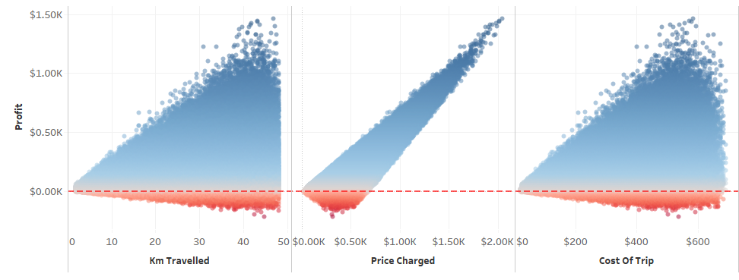
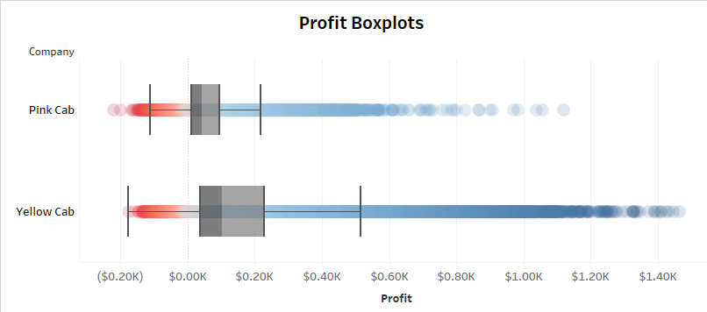
Profit
Profit = Price Charged – Cost of Trip.
Profit more correlated with Price Charged.
Profit varies at low Price charges but varies less as Price Charges increases.
Heteroscedasticity increases with increase in distance traveled. Same pattern for Cost of Trip.
Significant trips did not end in Profit.
Median Profit for Yellow Cab higher than Pink Cab.

Slide 17
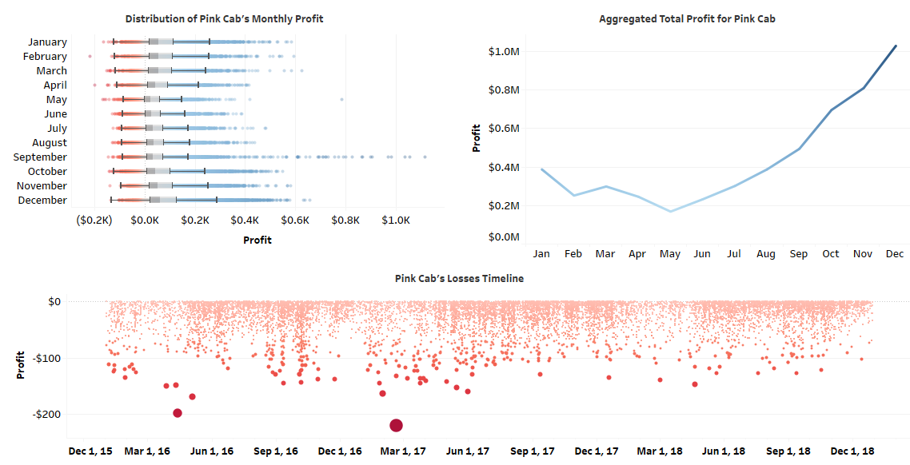
Pink Cab – Profit Analysis
Month likely associated with Profit.
Median Profit lowest in May for Pink Cab and highest during December.
Higher Profit outliers for month of September.
Total Profit highest in December (2016 to 2018).
Trip that ended in highest loss of $220 made in February 2017, followed by $199 in April 2016.

Slide 18
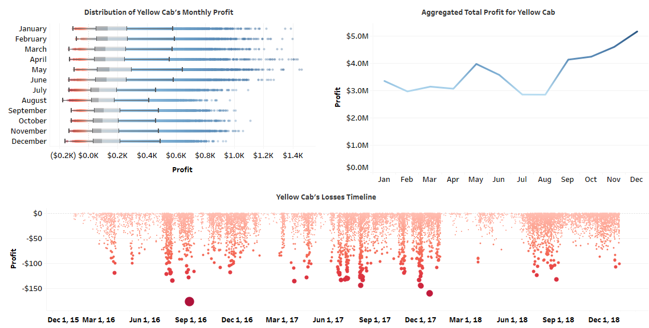
Yellow Cab – Profit Analysis
Yellow Cab profit significantly higher across all months compared to its rival.
Median Profit lowest during July and August.
Highest Total Profit in December (2016 to 2018),
Trip that ended in high loss of $177 made in August 2016, followed by $166 on December 2017.

Slide 19
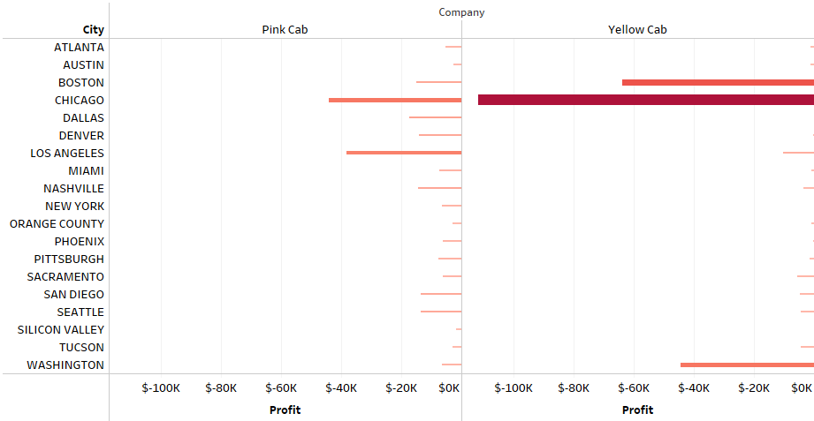
Loses by City
Yellow Cab makes highest total loses in Chicago, followed by Boston and Washington.
Pink Cab makes highest total loses in Chicago and Los Angeles.

Slide 20
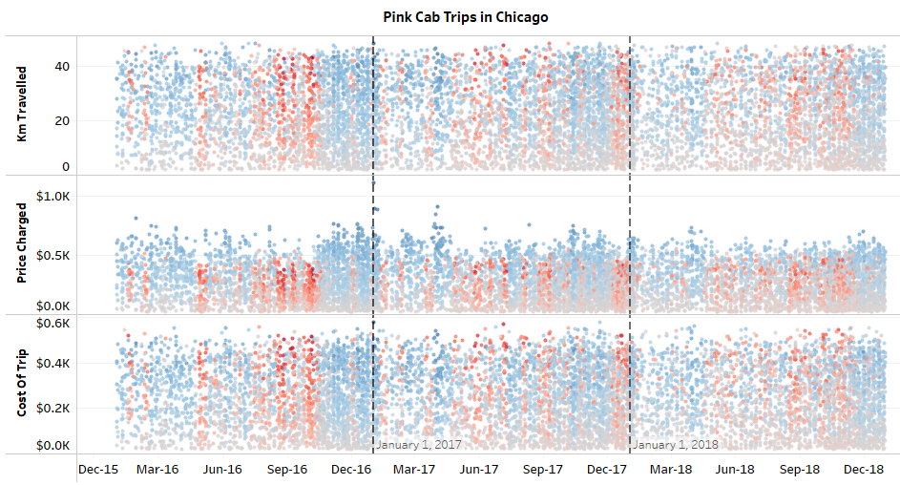
Analyzing Chicago Non-Profitable Trips – Pink Cab
Red represents trips that did not make profit (Loss).
Cab expenses was higher than Cab revenue for non-profitable trips.
In 2016, consistent non-profitable trips made during month of April, July, August, September, October.
In 2017 and 2018, although several non-profitable trips were made across many months, they are less in comparison with the year 2016.

Slide 21
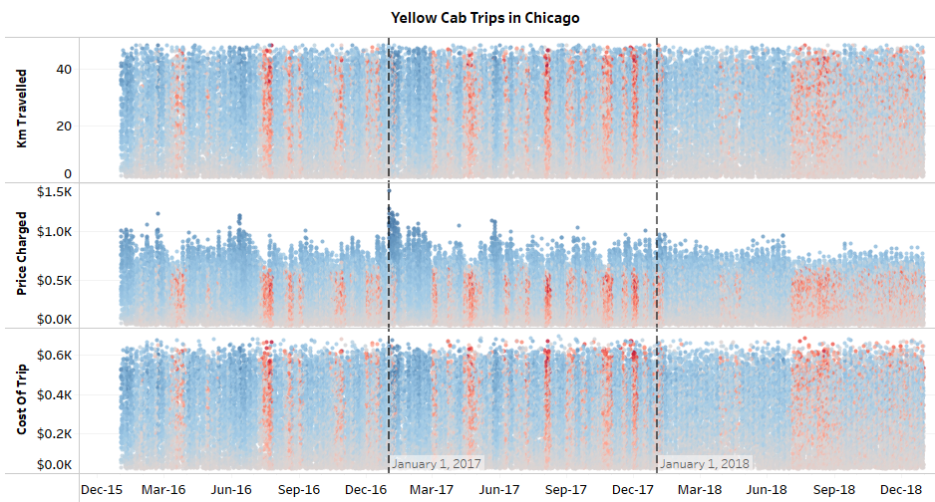
Analyzing Chicago Non-Profitable Trips – Yellow Cab
For Yellow Cab, July and August has highest number of non-profitable trips across all years.
2017 saw highest number of non-profitable trips across many months and 2018 saw the lowest number of non-profitable trips compared to other years.

Slide 22
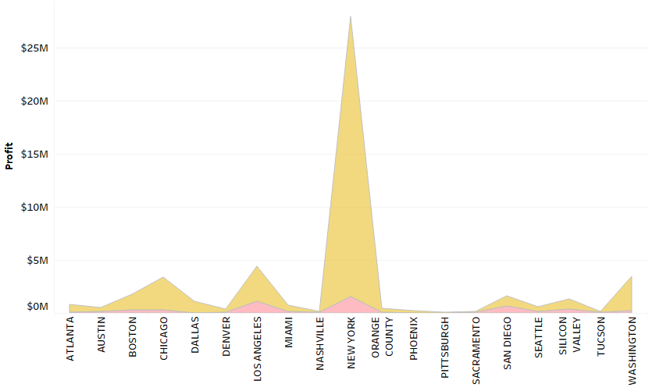
Profit by City (2016 to 2018)
Yellow Cab’s total Profit outperforms Pink Cab across all cities.
Highest total profit for both Cab companies is in New York.

Slide 31
Thank You

